Slide 1

Analysis of Telco Customer Churn Data
Presented By:
Jake Conard, Greg Lee,
Andrews FrImpong, natali newman

Slide 2

Telco Churn Problem Overview
Our company is recording data on all customers to allow for better customer retention.
We have gathered 19 data points that help us analyze why a customer decides to leave our telecommunications company.
We have utilized these data points to better analyze why a customer leaves our telecommunications

Slide 3

Datapoints Analyzed
Device Protection
Tech Support
Streaming TV
Streaming Movies
Contract Type
Paperless Billing
Payment Method
Monthly Charges
Total Charges
Gender
Senior Citizen
Partner
Dependents
Tenure
Phone Service
Multiple Lines
Internet Service
Online Security
Online Backup

Slide 4
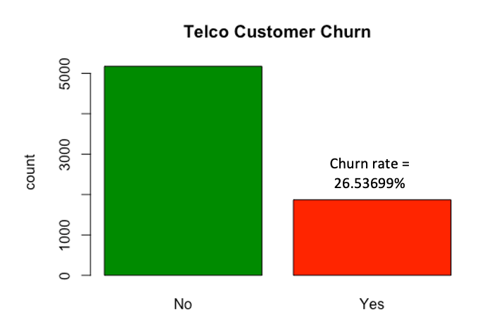

Slide 5
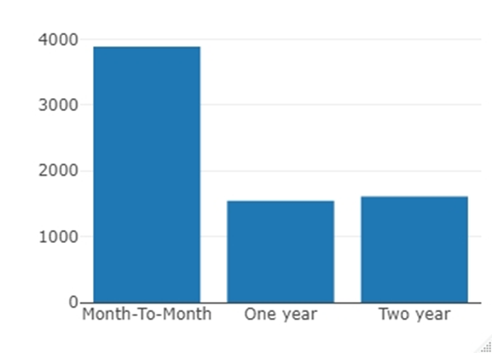
Customers Count by Contract type
The analysis shows that close to 4000 customers sign up for the month-to-month contract compared to around 1,500 each that opted for the one and two years contract. The analysis clearly indicates that customers prefer the month-to-month contract because of lack of trust, it can also be that the cost of one and two years contract compared to the month-to-month are the same in annual terms.

Slide 6
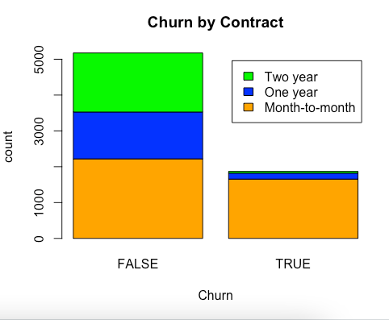
Churn by Contract Type

Slide 7
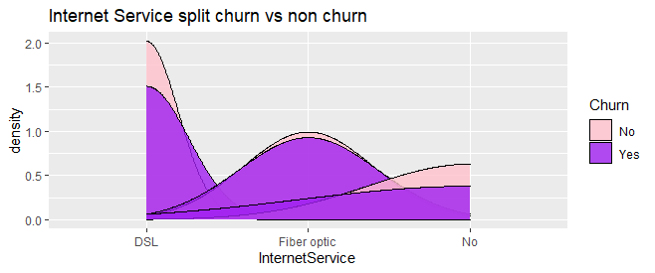
Churn by Internet Service
During the analysis we determined that almost 41% of customers with the Fiber Optic internet service left the company over the last month.
This above average churn for one specific type of internet service and likely the most expensive is alarming.
Recommend that we investigate the performance and the cost of the Fiber Optic internet service to determine if one of those factors is the likely culprit.

Slide 8
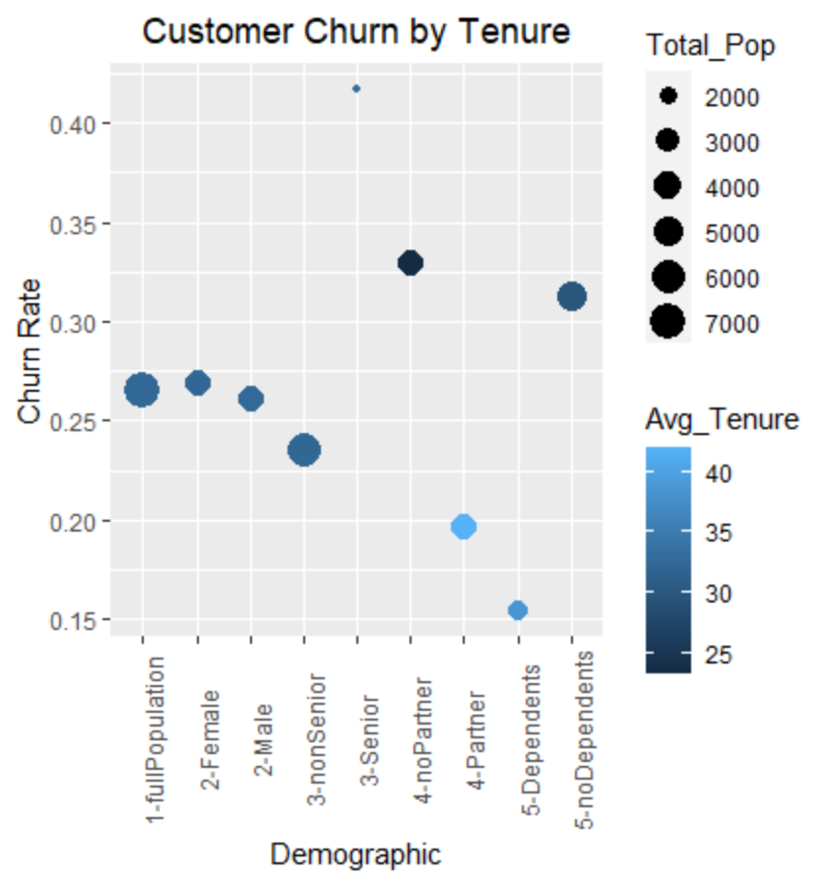
Customer Demographics
Analysis Findings:
noPartner & noDependents group have churn rates above the average rate for the fullPopulation
Higher churn rate and low tenure within noPartner & noDependents groups that make up large segment of customer base
Is Senior group an outlier? Has above average tenure but also the highest churn rate, raises question of possible sampling error.

Slide 9
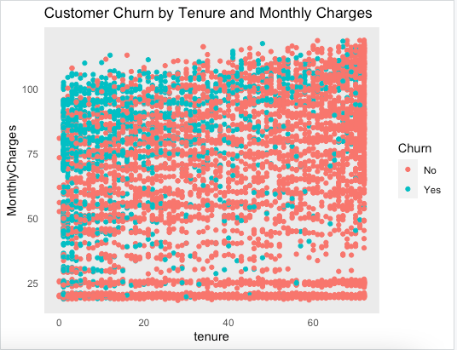
Churn by Tenure
Churn is represented in green.
Note highest churn among those with high monthly charges and low tenure.
Note the group in the $20-30 monthly charges range, in our analysis these individuals appear to have phone service only and no internet/ TV streaming.

Slide 10
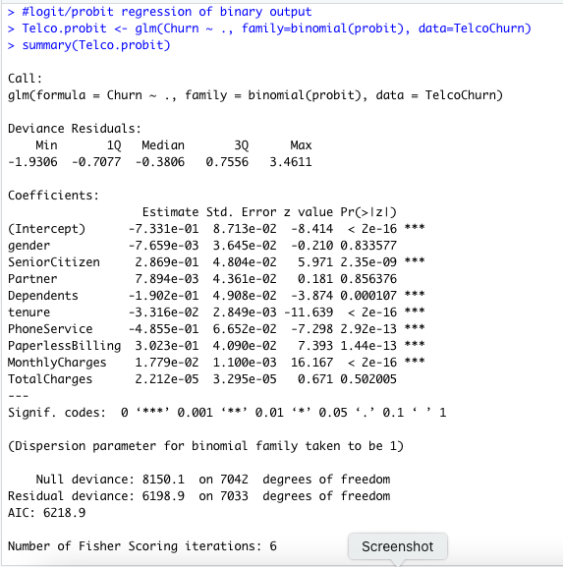
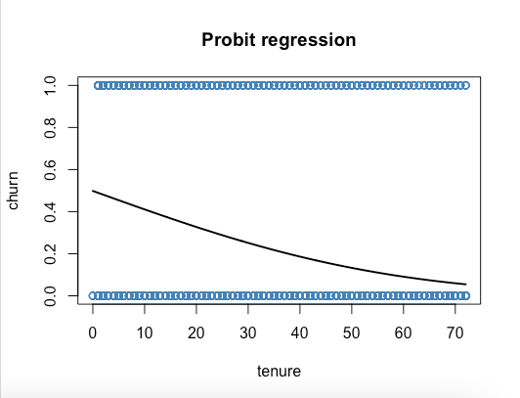
Probit regression
Probit regression was used because we have non-linear data.
Gender, Partner and Total Charges do not appear to be significant predictors of Churn whereas all others appear to be significant.
Churn as predicted by tenure is plotted to the right.

Slide 11
Conclusion & Recommendations
Based on our analysis we believe that the main contributing factors to customer churn at Telco is due to month-to-month contracts, issues relating to the fiber optic internet service, high monthly charges, and single person households.
We feel confident in making the following recommendations:
Either: 1) Incentivize month-to-month customers to commit to a longer contract (one year or two year). Or 2) since the average charge for the three-payment method is almost the same, the company could increase the price for the month-to-month contract to differentiate it from the other two contract types. The same approach should use for the payment method.
Investigating the Fiber Optic internet service to see if the price is too expensive or if the service is under performing.
Give first-time customers a discount during the first year to reduce the churn during this time period.
NoDependent and NoPartner demographic groups are more likely to churn and should be targeted with incentives or promotions that reward longer tenure.
Looking at the cost benefit analysis of adding online security and technical support to all accounts to alleviate churn based on the absence of these services.

Slide 12
Questions?

Slide 13
Backup Slides

Slide 14
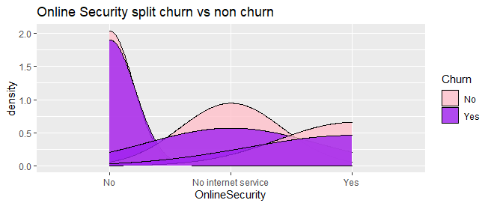
Churn by Online Security Service
During the analysis we determined that almost 42% of customers without Online Security support provided left the company in the last month.
This above average churn for an additional service on an account.
Recommend that we investigate the online security benefits and if that is something that we should offer to all customers regardless of service type.

Slide 15
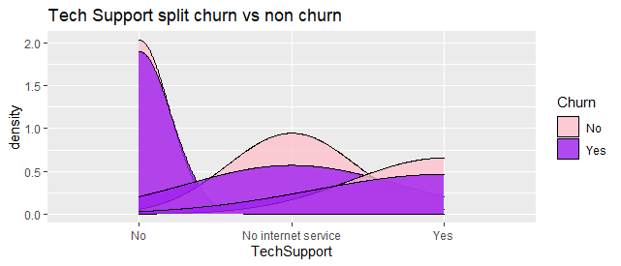
Churn by Tech Support Service
During the analysis we determined that almost 41% of customers without technical support provided left the company in the last month.
This above average churn for an additional service on an account.
Recommend that we investigate the technical support benefits and if that is something that we should offer to all customers regardless of service type.

